Slide 1
Appropriate Use Criteria for Advanced Diagnostic Imaging
Due to the federal Protecting Access to Medicare Act (PAMA) of 2014, CMS has mandated an initiative nationally to link advanced imaging to appropriate indications for use. Effective January 1, 2021, CMS will require that the provider’s order meet criteria for appropriate use of specific imaging tests including CT, MRI, PET and NM studies.
This requirement was moved to be effective January 1, 2022
This applies to Ambulatory and Hospital Outpatient departments, including ED
We’ll be using a product called CareSelect for the appropriateness decision support
This will also affect external providers entering OP orders electronically through Meditech
Paper orders faxed to centralized scheduling will need to have a reason for exam included

Slide 2
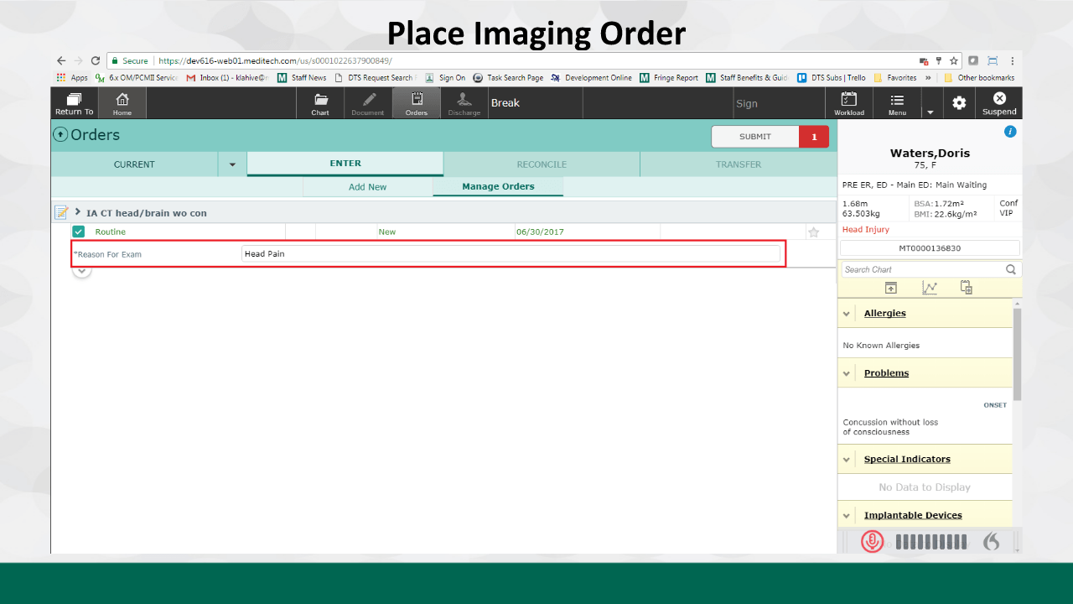

Slide 3
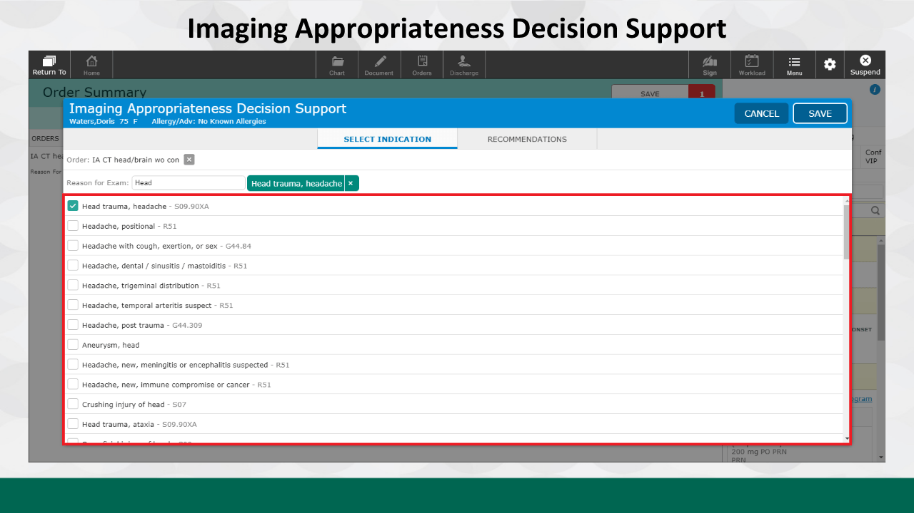

Slide 4
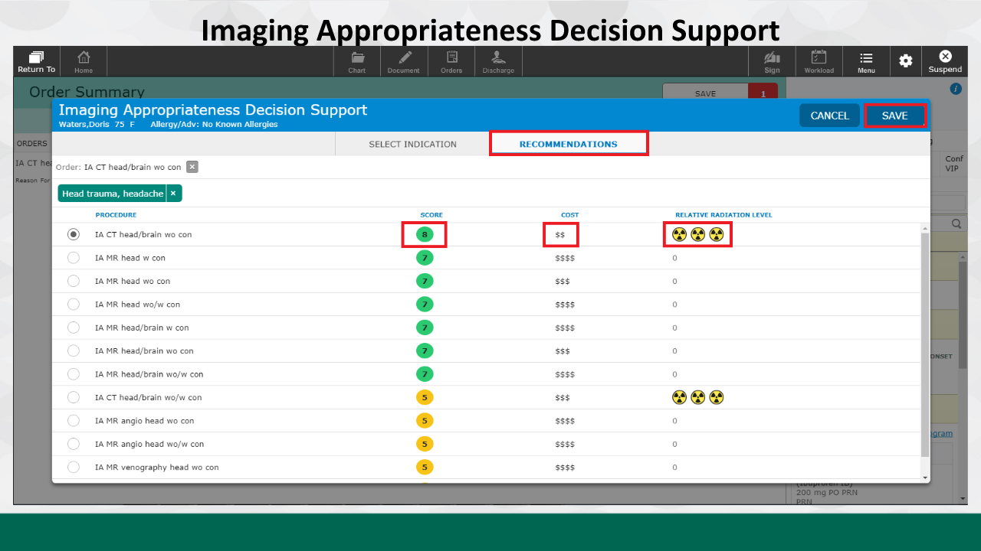
Scores:
Scores are based on reason for exam selected, patients age, sex, cost and relative radiation levels
Green (7-9) indicates appropriate use
Yellow (4-6) indicates neither appropriate or nor inappropriate
Red (1-3) indicates not appropriate

Slide 5
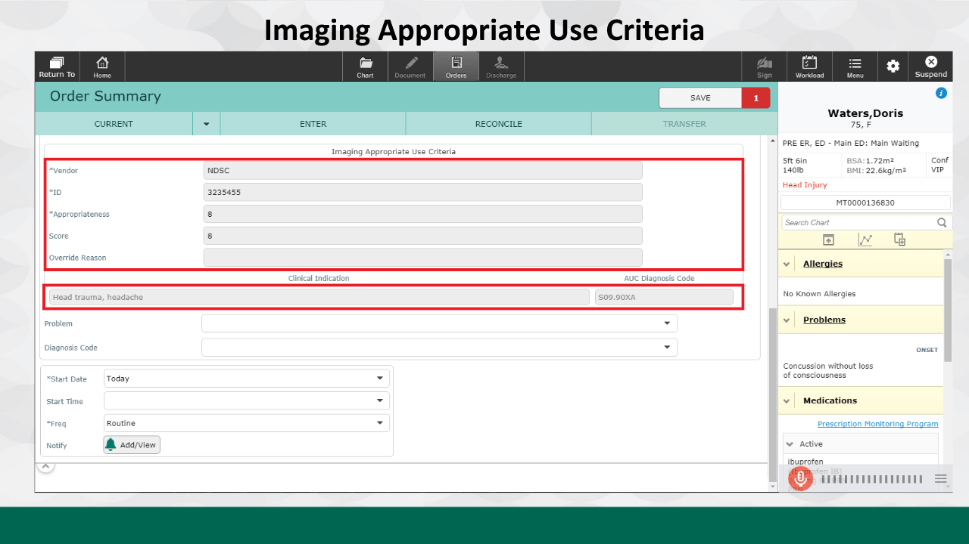

Slide 6
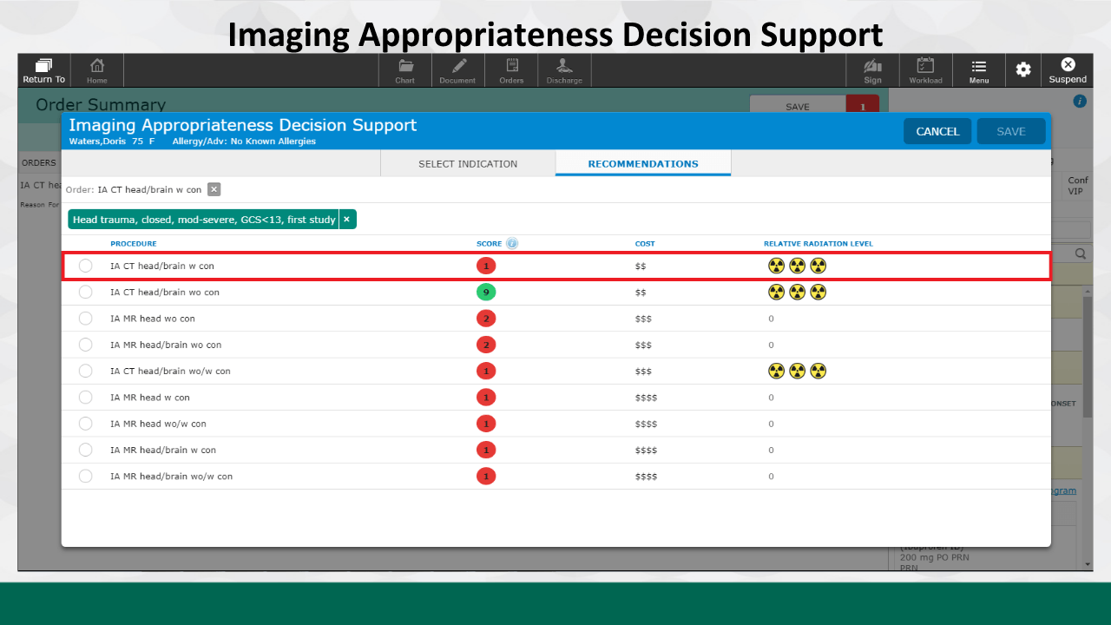

Slide 7
